Slide 1


Media Integrator
October 31, 2014
Presenters name, Title - Date

Slide 2
Agenda
Overview
Configure Application
ErCerRunAtd0
Unattached Files Application

Slide 3
Overview
October 31, 2014

Slide 4
Overview
The Media Integrator provides for the storage of relationships between Facets and external media.
Any files in the existing document management system, such as FileNet and MACESS EXP, can be attached to records in Facets.
The media/documents are viewable in Facets Interactive. Or, Facets can launch external applications.
Need to configure a Facets application to activate the Media Integrator
We will walk through the steps in this training session.

Slide 5
Configure Application
October 31, 2014

Slide 6
Configure Application
Configure Subscriber/Family Application to add the Media Integrator functionality.
Create a new Open Related File component.
Create an attachment style.
Configure a new Form Definition Style ID.
Configure a new Attached Files Panel component.

Slide 7
ErCerRunAtd0
October 31, 2014

Slide 8
ErCerRunAtd0
This job creates attachment rows for existing Facets records.
The Input Driver parameter determines type of request to be processed
Input File Requests
The batch job reads a input file and creates attachment rows
Process Item Requests
This batch job reads the letter request submitted by Facets Workflow, and creates attachment rows.

Slide 9
ErCerRunAtd0
This job creates attachment rows for existing Facets records.
The Input Driver parameter determines type of request to be processed
Input File Requests
The batch job reads a input file and creates attachment rows
Process Item Requests
This batch job reads the letter request submitted by Facets Workflow, and creates attachment rows.
In this session, we will focus on the Input File Requests.

Slide 10
ErCerRunAtd0
Runbook parameters to override
InputDriver
“FILE” for Input File Process
“PITM” for Process Item Requests
AttachmentType
“ATDT” for Input File Process
“ATLT” for Process Item Requests
InputFile
If InputDriver is “FILE”, this parameter has the fully qualified name of the input file.

Slide 11
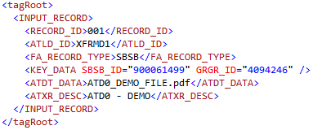
ErCerRunAtd0
Sample Input File
ATLD_ID Form ID (e.g. XFRMD1)
FA_RECORD_TYPE Facets source records (e.g. SBSB)
KEY_DATA Keys to identify the record in Facets
ATXR_DESC Short description

Slide 12
ErCerRunAtd0
FA_RECORD_TYPE and KEY_DATA
For each FA_RECORD_TYPE, you could pass the specific KEY_DATA.
FA_RECORD_TYPE | KEY_DATA
SBSB (Subscriber) | SBSB_CK SBSB_ID + GRGR_ID
MEME (Member) | MEME_CK SBSB_ID + GRGR_ID + MEME_SFX
PRPR (Provider) | PRPR_ID
CLCL (Claim) | CLCL_ID
CSTK (Customer Service Task) | CSSC_ID + CSTK_SEQ_NO

Slide 13
Unattached Files Application
October 31, 2014

Slide 14
Unattached Files Application
What if…
the input XML file doesn’t have the correct KEY_DATA?
the ATD0 job can’t find the source record?
The media would be viewable in the Unattached Files application.
Use the Unattached Files to add the media to the correct Facets source record.
Facets Workflow must be enabled and configured.
The CUSTOM_COLL node may be added to aid the identification of a Facets record.
Unlimited number of nodes can be created within the CUSTOM_COLL node.
The CUSTOM_COLL node can’t be used by Facets Workflow for qualifying records.

Slide 15
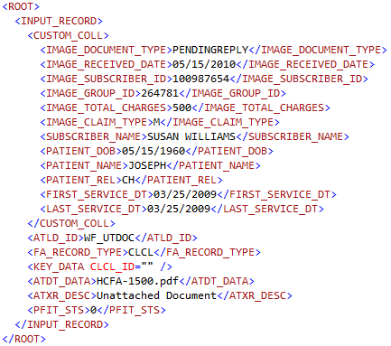
Unattached Files Application

Slide 16
Assignments
October 31, 2014

Slide 17
Assignments
You are tasked to demonstrate the Media Integrator functionality. The requirements are as follows…
Interactive
The Media Integrator should be available in Medical Claims Processing application, and Custom Service Application.
The Media Integrator should be configured to open an external application to view the media files.
ErCerRunAtd0
Create an input file to attach media files to Facets Subscriber records.
Confirm the media files are correctly attached to the source records.

Slide 18
Q & A
October 31, 2014

